Slide 1
MTT The Mobile Transportation Tracker
Anjelika Sah
Ekta Chaudhary
Abhay Raut
Prajwol Lamichhane
Notes:
<number>

Slide 2
What / Why “MTT”?
What : MTT is a mobile transportation tracker application which tracks the location of the buses registered on our database on google map.
Why: To save one's valuable time waiting for the bus on the bus stop

Slide 3
Objectives
To contribute for smart city by implementing intelligent transportation system within the country
To facilitate people by providing location of respective buses they are waiting for
To make sustainable transportation popular by the means of technology
To save one’s time waiting for the bus
To learn Android framework of Java and develop concepts of API

Slide 4
Tools Used
Front End
GIMP
Android Studio
Photoshop
Back End
Firebase
Google Maps/ Google Maps API

Slide 5
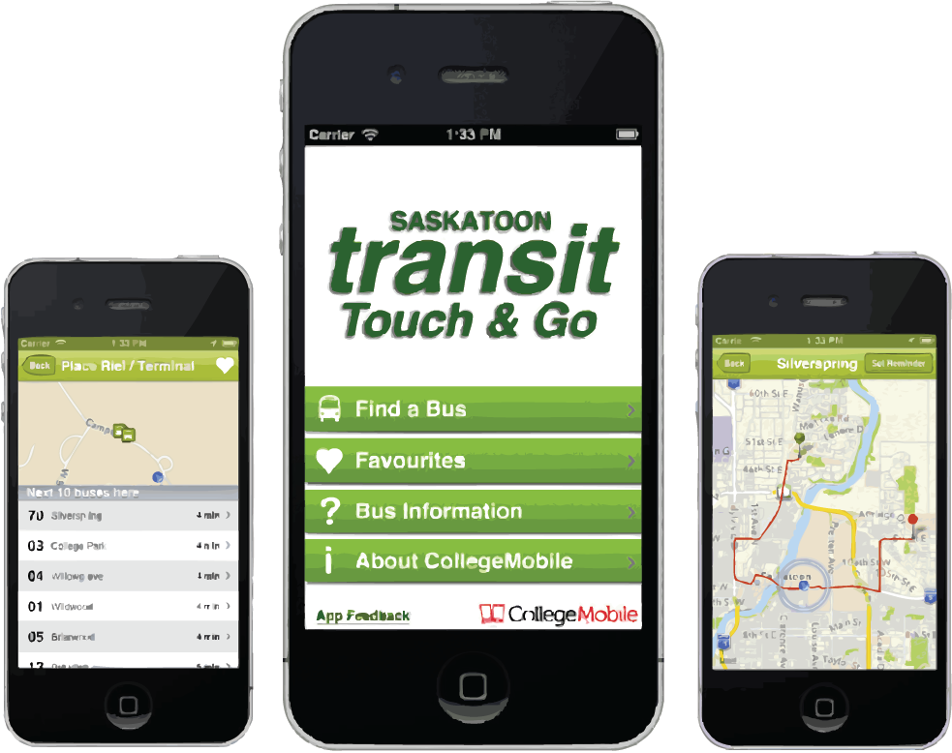
Related Works
Transit
Transit is a real-time urban travel companion that navigates city’s public transit system with accurate real-time predictions, simple trip planning, step-by-step navigation, service disruption notifications, and departure and stop reminders. Its key features involve knowing when the bus or train will arrive in real time, planning trips from A to B with ease, knowing the exact location of the buses.

Slide 6
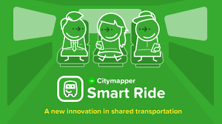
Related Work
City Mapper
City Mapper is another similar ultimate transit app, making cities easier to use. It checks nearby departures in real-time, find the fastest route combining bus, subway, train, ferry, taxi, car, etc, following step-by-step directions, including the best subway exit to reach the platform and receiving alerts when the favorite lines get disrupted.

Slide 7
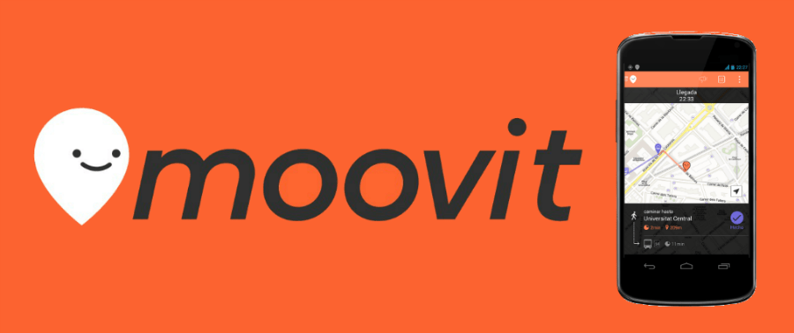
Related Work
Moovit
Moovit is another similar application that finds the nearest train station to the destination whether which destination is close to the home, how far is it from the walking distance, from when the train of the day departs, when the first bus line starts operating, etc Moovit is basically functional when it comes to real-time arrivals, directions, real time updates, user reports, maps view, favorite line, stations and places, etc.

Slide 8
Take Way
Easy to use
Free
Mobile Application Based
Individual friendly
Realtime
Multifunctional

Slide 9
Design and Implementation
Landing page
User Log In
Bus Log In
Maps Activity
Bus Sign In
Bus Sign Up
Map Activity
Logout
Send Location
Fig: Use Case Diagram

Slide 10
Database Design and Implementation
First Node
bus_NO
pin
Vertex
id
Buses
Owner_Name
password
Latitude
Longitude
Firebase Database
Tree Diagram

Slide 11
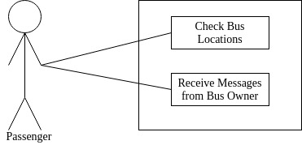
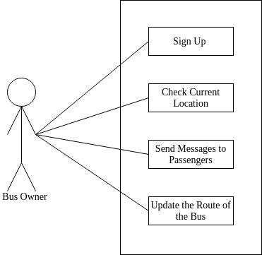
Use Case Diagram
Passenger/User View of Application Vehicle driver view of application
Notes:
<number>

Slide 12
Features
Real Time Location of Buses
Implementation of Satellite view on Map
Multifunctioning
Messaging function in case of problems like traffic jams and road accidents

Slide 13
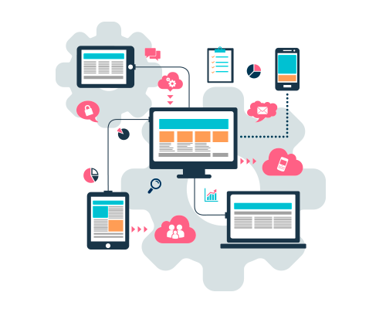
Back End

Slide 14
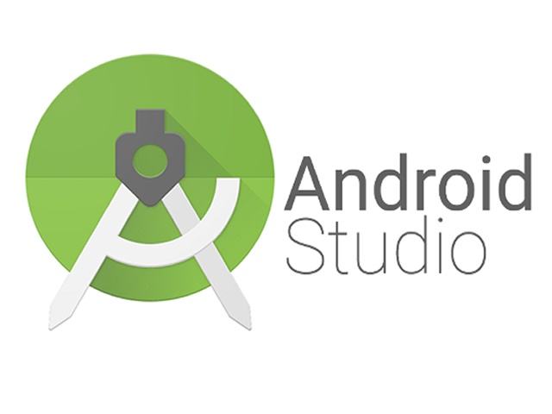
Software
Android Studio
Android Studio is the official integrated development environment (IDE) for Google's Android operating system, built on JetBrains' IntelliJ IDEA software and designed specifically for Android development.
It supports Java, Kotlin and also Python.

Slide 15
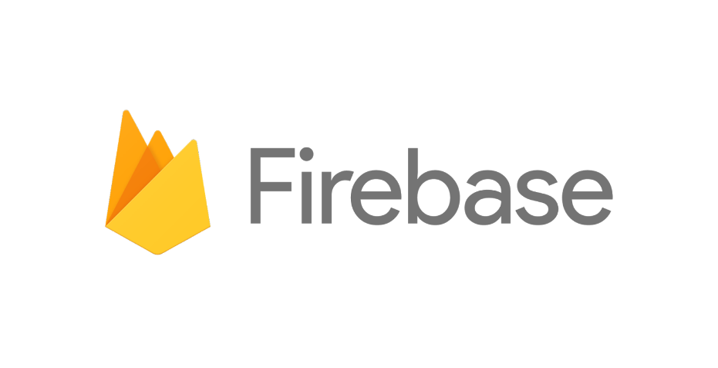
Software
Firebase
Firebase is a mobile and web application development platform developed by Firebase, Inc. in 2011, then acquired by Google in 2014.
Its services are authentication, cloud messaging, analytics, real time database, file storage, firebase hosting and many more.

Slide 16
Limitations
We could not update the real time location of buses because the firebase could only accept limited number of requests. When the application was made real time, the number of requests exceeded above 2500 within a day and the google automatically disabled our app because for real time update we had to buy permission from google. So, update the google json file with a new account and made the location update manual.
So, the real time location had to be done manual update. This is our limitation.

Slide 17
Future Enhancement
Getting a GPS tracker devices like Arduino to implement it on the real world
Making specific routes for the concerned users only

Slide 18
Conclusion
“MTT” has been a good team work; all the team members have tried their best for its creation. Also by the support, guidance and motivation from our supervisor on a positive working environment, we have successfully developed “MTT”. We believe that whether it's public transit or car renting, we believe the revolution taking over our streets will be captained from our phones very soon in the future.

Slide 19
Thank You

